Slide 1
The London Anchor Institutions' Network
Working together for a fairer, greener, more prosperous London
Notes:
OPTION 2 – DARK BACKGROUND

Slide 2
About the network
The London Anchor Institutions’ Network (LAIN) is London’s first city-wide initiative, convened by the Mayor of London, committing institutions to collaborative impact, using their procurement, recruitment and estate management capacity for social and economic benefit.
London faces unprecedented challenges. By acting together, London’s major public and private sector institutions can find new ways of building resilience and tackle long-standing problems and new threats to the city.
By working together towards shared goals - tackling inequalities, supporting inclusive economic growth and taking action in the face of climate change - we can make a bigger and more positive change than we would by working alone.
Leveraging the collective power of the network, we can build a better London, creating the social and economic conditions our own organisations also need to flourish.
This presents immense opportunities to change the lives of Londoners.

Slide 3
How it all began
In March 2021, some of London's biggest organisations came together to support the capital’s recovery from the COVID-19 pandemic.
The pandemic exposed and exacerbated long standing inequalities within London and highlighted the growing urgency of the climate emergency.​
​
In response, the Mayor of London and London Councils convened some of London's leading organisations across the public sector, business, trade unions and community groups to lead London's recovery and mitigate the worst effects for those hardest hit. ​
​
A number of organisations from this 'London Recovery Board' came together to form the London Anchor Institutions' Network.
Two years on, the work of the network is just as relevant as when it began.

Slide 4
Membership
The network has a growing membership across the public, private, faith-based, education and cultural sectors​
​
​Who collectively represent dozens of anchors across the city
​
Employing tens of thousands of people, spending billions of pounds a year and managing millions of square metres of real estate​
​
We are working together to make a significant difference

Slide 5
How it works
The network’s goals are bold and ambitious
To build a better London for everyone - a city that is more inclusive and sustainable, where economic opportunities are available to all and take less of a toll on our planet.
Individual 'anchor institutions’ (including us) support this mission by:
Setting targets in relation to recruitment, procurement and estate management practices ​
Sharing learning and best practice about how to baseline, define and then deliver against these targets
Collaborating on joint projects such as job fairs, supplier databases or training

Slide 6
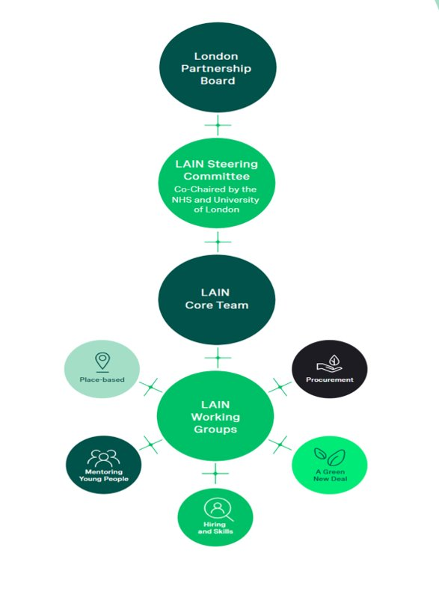
Governance
The network reports to the London Partnership Board, co-chaired by the Mayor of London and Chair of London Councils, which brings together leaders from across London’s government, business and civil society, health and education sectors.
A Steering Committee, co-chaired by Professor Wendy Thomson CBE, Vice Chancellor of University of London and Martin Machray, Executive Director of Performance - London, NHS informs LAIN's strategic priorities and oversees their execution.
Representatives from member organisations sit on and chair working groups which are driving progress and sharing practice.
The network is supported by a core team at City Hall who provide strategy and policy expertise, programme management, communications and project support. Pro bono support is also provided by Bloomberg Associates.

Slide 7
The network's focus
Hiring and Skills Good work and inclusive workplaces
Procurement Inclusive growth through more local SME procurement
Mentoring Young People Improving life chances through quality mentoring
A Green New Deal Accelerating London's drive to net zero

Slide 8
Hiring and Skills
Goal: Support ‘good work’ and become more representative of London’s communities
Deliverables:
Help more Londoners from underrepresented backgrounds into good work
Make progress in closing gender, ethnicity & disability pay gaps
Progress measures:
No. of London Living Wage (LLW) apprenticeships
No. of supported internships
Amount of Apprenticeship Levy pledged to SMEs
Pay gaps published and narrowed
New LLW / Good Work Standard accreditations
Organisational benefits can include:
Addressing skills gaps​
Increasing employee satisfaction and motivation​
Increasing retention rates​
Reducing costs associated with staff turnover​
Increasing innovation and creativity through diversity of perspectives and lived experience ​
Being more responsive to the needs of communities you serve by being more reflective of them ​
Communicating positive organisational values to stakeholders ​

Slide 9
Procurement
Goal: Support inclusive economic growth by buying a greater share of goods and services from London-based, diverse MSMEs
Deliverables:
Increase the proportion of goods and services purchased from Micro, Small and Medium Enterprises (MSMEs) and diverse-owned businesses (both directly and via tier 1 suppliers).
Progress measures:
Spend with MSMEs and diverse-owned businesses
No. and £ of contracts reserved for MSMEs
No. of London MSMEs reached through market engagement/ supplier readiness activities
No. of procurement staff completing e-learning
Organisational benefits can include:
Securing more responsive services and greater innovation ​
Adapting more easily to changing technologies and environments by letting shorter, smaller contracts ​
Achieving greater supply chain resilience​
Reducing transport-related costs and environmental impacts by buying locally ​
Demonstrating a commitment to inclusive local economic growth to stakeholders and local communities

Slide 10
Green New Deal
Goal: Tackle the climate emergency by accelerating London's move to net zero
Deliverables:
Decarbonising estates
Ensuring a robust, trained workforce to meet decarbonisation needs
Progress measures:
Net zero targets in place
Sqm of estate identified for decarbonisation (and by when)
No. of staff who have done carbon literacy or environmental sustainability training
Organisational benefits can include:
Reducing waste and operational costs​
Reducing costs of climate adaptation and mitigation in the longer term ​
Being better prepared for future environmental regulations​
Attracting and retaining staff who want to work for responsible employers ​
Increasing job satisfaction through green skills development ​
Improving organisational reputation amongst stakeholders

Slide 11
Mentoring
Goal: Improve life chances and opportunities for disadvantaged young Londoners through quality mentoring
Deliverables:
Work in partnership with the voluntary and community sector and youth support organisations to identify, train and match mentors with young people most in need.
Progress measures:
No. of mentors identified
No. of mentors completing mentoring training
No. of mentors matched with mentees
Organisational benefits can include:
Mentors experiencing an increase in job satisfaction​
Organisations benefitting from greater employee engagement ​
Mentors developing new skills that can help career progression​
Mentors and organisations gaining greater insight into their local communities and the challenges they face​
Organisations building connections with community organisations which can lead to mutually-beneficial partnership working ​
Meeting CSR objectives and supporting comms about organisational values

Slide 12
Our participation in LAIN
Procurement
Hiring & Skills
Green New Deal
Mentoring
[Insert targets you have committed to and any other relevant information e.g. representatives from your organisation on the LAIN working group]
[Insert targets you have committed to and any other relevant information e.g. representatives from your organisation on the LAIN working group]
[Insert targets you have committed to and any other relevant information e.g. representatives from your organisation on the LAIN working group]
[Insert targets you have committed to and any other relevant information e.g. representatives from your organisation on the LAIN working group]

Slide 13
Network impact
£750m spent with small & diverse businesses in the last financial year
1,000 members of staff trained in carbon literacy or environmental sustainability
70+ buildings prioritised for decarbonisation
10 London anchors accredited to the Mayor's Good Work Standard
4,000+ apprentices supported in the last year
7,000+ Londoners' pay uplifted through new London Living Wage accreditations
Dozens of mentors identified and being trained to support disadvantaged young Londoners
100 small businesses supported through supplier readiness programmes and events
Watch more about the impact of the network here

Slide 14
[SHOW YOUR ORGANISATION’S IMPACT VIDEO HERE]
Real lives. Real voices. Real impact!
***EXAMPLE***

Slide 15
Comms opportunities
Being part of the conversation using the hashtag #LondonAnchors
Sharing impact through impact videos
Sharing good practice through blogs, case studies and news stories across LAIN's channels
Talking about participation in the network and what's being achieved using the LAIN comms assets across other channels

