Slide 1
Procurement Working Group
#LAIN
#LondonAnchors
Notes:
OPTION COVER 1

Slide 2
Procurement
Why we're doing this
Using our spend to drive inclusive economic growth and provide employment opportunities, to benefit Londoners as well as the local and wider economy
Ensuring our procurement processes are accessible, inclusive and support supplier diversity
Securing more responsive services and greater innovation ​& supply chain resilience​
Reducing transport-related costs and environmental impacts by buying locally ​
Goal: Use our purchasing power to support more inclusive economic growth
Key deliverable:
Buying more of our goods and services from Micro, Small and Medium Enterprises (MSMEs) and diverse-led businesses
#LondonAnchors

Slide 3
Who we are working with
Thames Water
NHS
Transport for London
GLA Group &
The Metropolitan Police Service
(Co-Chairs)
Westminster
City Council
University of London
London Fire Brigade
Notes:
OPTION 2 – DARK BACKGROUND

Slide 4
Procurement Action Plan 2022-2023
Accountability | Activity | Detail
Intelligence & Market engagement
Collective | Database | Explore creation of shared database of small and diverse suppliers
Collective | Events | Participate in 1-2 LAIN market engagement events per year targeting small and diverse businesses
Individual | Forward pipelines | Publish plan of goods and services to be procured, up to 6 months in advance
Collective | Spend data | Tracking spend with small and diverse businesses
Lowering barriers for MSMEs
Collective | Information & guidance | Publish guides on social value and public sector procurement
Individual | Payment terms | Review payment terms and feasibility of 10-day payment periods for MSMEs
Individual | Indemnity insurance | Review proportionality of insurance levels required of small and diverse suppliers/contracts
Individual | Simplify documents | Review options to adopt simplified legal Terms and Conditions documents for contracts <£50K
Collective | Officer training | Develop and roll out training for Procurement staff
Individual | Reserve contracts | Reserving under threshold contracts specifically for SMEs
Notes:
OPTION 2 – DARK BACKGROUND

Slide 5
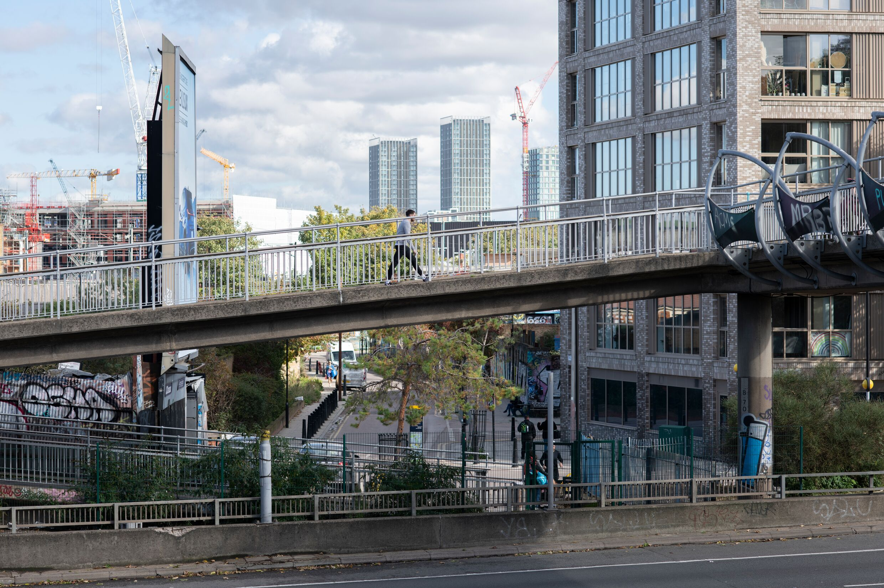
Our Impact 2021-2023

Slide 6
Our Impact 2021-2023
£1.75bn
Worth of contracts entered
into with MSMEs
10,000
Businesses accessing bespoke guides on social value and public sector procurement
1,200
Contracts signed with London’s smaller &
diverse-led businesses
100+
Smaller and diverse-led businesses benefitting from collaboratively
hosted events
4
Members made changes
to insurance level requirements and
practices in 2023

Slide 7
Challenges
…We are making great progress, but things could always improve, particularly
Data systems & collection including business size, diversity and location information
Cross-team collaboration Particularly with colleagues in Finance, Legal and Risk/Insurance, whose input is essential
Communication Effectively cascading information and uptake of policy and assets we’ve produced
Colleagues can help unblock these by:
Upskilling your teams with our e-learning modules on how they can support smaller and diverse businesses when buying goods or services
Ensuring teams are reserving contracts where appropriate
Sharing your pipelines early once budgets are set for the best chance of promoting contracts to MSMEs, particularly those we have not contracted with before
Collaborating with us on stubborn challenges that involve your team

