Slide 1
Meet the Buyers Tuesday 29 June 2023
#LondonAnchors
Notes:
OPTION COVER 1

Slide 2
Patrick Nicholson Buyer Engagement Expert, Newable

Slide 3
Housekeeping
@MayorofLondon
@ldn_gov
#LAIN #LondonAnchors
Connect. Be inspired. Take action

Slide 4
Agenda
Programme overview
10:00 – 10:20: Welcome & introductions
10:20 – 10:40: Navigating public procurement
10:40 – 11:00: Writing a successful bid
11:00 – 11:30: Refreshments & networking
11:30 – 14:00: Meet the buyers / lunch
14:15 – 15:45: Understanding social value
15:45 – 16:00 Finish
10:00 – 16:00
#LondonAnchors
Notes:
OPTION 2 – DARK BACKGROUND

Slide 5
Alex Conway Assistant Director, Economic Development, Greater London Authority

Slide 6
Rajesh Agrawal Deputy Mayor, Business

Slide 8
Example goods & services pipeline
Buyer | Category | Project Name | Contract value
TfL | Professional Services | Architect Services – Buckingham Palace Road | £100K - £200K
TfL | Facilities Management | Down Street station mid tunnel vent system removal | £1M - £5M
TfL | Facilities Management | Cleaning and Associated Services (Pan TfL) | >£50M
TfL | IT | Payment Infrastructure – Hardware & Software Requirements | £500K-£1M
TfL | Facilities Management | Courier Service - Lost Property Office | £200K-£300K
TfL | Professional Services | Notetaking Services | £100K - £200K
TfL | Professional Services | Pensions Consultancy Support | £300K-£400K
TfL | Facilities Management | Gloucester Road Artwork Fabricator | £100K - £200K
TfL | Professional Services | Campaign Based Marketing Activities | £500k-£1M
TfL | Professional Services | Recruitment Marketing | £1M - £5M
GLA | IT | Telephony Modernisation Project | £25M-£50M
GLA | Professional Services | Research and Evaluation - Youth Social Action and Employability | £100K-£200K
GLA | IT | GLA desk availability system | £100K-£200K
GLA | IT | London Business Hub website support | £100K-£200K
#LondonAnchors
Notes:
OPTION 2 – DARK BACKGROUND

Slide 9
Session 1
Navigating
public
procurement
Carol Hustler Director,
TEDs Friends
#LondonAnchors
Notes:
OPTION 1

Slide 10
Great opportunities – good for business
Useful websites & portals
Why procurement can be complex
How to respond in the right way

Slide 11
Real opportunities exist
LAIN members collectively spend over £73 billion each year
Total UK public procurement spend over £350 billion p.a.
Payment terms 10 – 30 days (average)
Actively seeking wider range of supplier applicants
Policy initiatives (reserved contracts, location)
Contract format (frameworks, dynamic purchasing systems)
Evaluation focus (social value, carbon reduction, innovation)

Slide 12
Benefits for your business
High profile client name increases your visibility
Regular work allows you to make longer term plans
Cash-flow stability
Opportunity to learn more about systems and procedures needed by other large organisations

Slide 13
Where to find opportunities
www.find-tender.service.gov.uk
www.contractsfinder.service.gov.uk
www.londontenders.org
Access current tenders and register for free email alerts.
Also find information for future opportunities and details of contracts awarded.
Other specialist sites:
https://bluelight.eu-supply.com/opportunities
www.supplying2nhs.org

Slide 14
Procurement can be complex
Public sector has a duty to achieve best value with its spend (it's your money, after all!)
Procurement processes enable transparency and effective comparison between potential suppliers
Tender responses are the basis for future contract terms
Think of procurement as organisational shopping:
gathering market information
finding new products & suppliers
getting added value
managing risk

Slide 15
Respond in the right way
Provide all information requested
Respond to the specific opportunity
Provide effective & relevant evidence
When you copy and paste, make sure it’s accurate and relevant for this opportunity
Show how you’re a good fit
If something isn’t clear, ask for clarification

Slide 16
Standard supplier questionnaire

Slide 17
Recognise the right opportunities
Size of contract (proportionality rule)
Location
Ability to supply all elements requested (check suitability for sub-contracting)
Your available time for responding effectively
The time it will take for the tender process to complete
Three good reasons for why you!

Slide 18
Your co.
Direct & indirect opportunities in supply chains
Council / Buying Organisation
Your co.
Your co.

Slide 19
Your co.
Direct & Indirect opportunities in supply chains
Council / Buying Organisation
Your co.
Arms-Length Management Organisation
Your co.
Your co.
Developer
Your co.
Your co.
Project Management
team

Slide 20
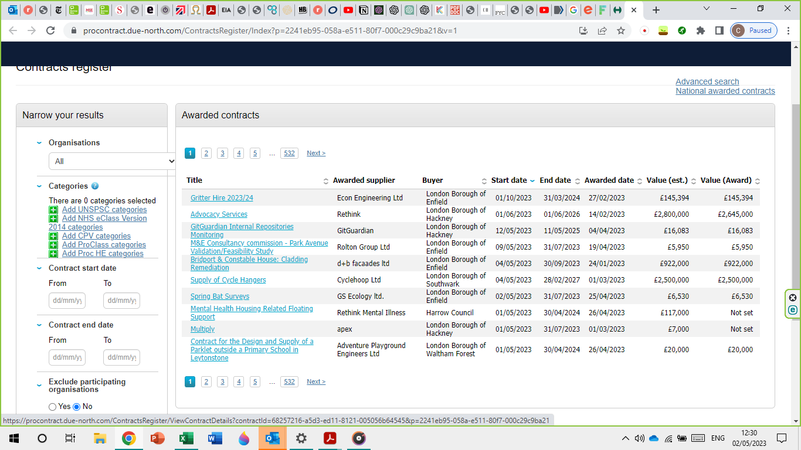
Low value direct spend
Potential supply chain opportunity

Slide 21
Questions?
Carol Hustler, TEDs Friend Ltd
carol@tedsfriend.co.uk
Tel: 07791 045699

Slide 22
Session 2
Writing a
successful bid
Dewi Hughes Founder & MD,
Silverlock Tenders
#LondonAnchors
Notes:
OPTION 1

Slide 23
My Background
years running Silverlock Tenders
years’ experience working for government (DTI & GOEM)
13
21
12 years appraising bids for government finance
4 years writing for Government ministers
4 years managing large European programmes
Notes:
9.35 Intro
9.40 questions
How many people have written a PQQ or tender? How many have written over 5 PQQs?
Write down what 1 thing do you want to get out of the the workshop and 2 specific questions you might have – 3 minutes. Get results and write them on flipboard
Try and answer these as I go through today.

Slide 24
What we do
One of the main tender and bid writing companies in the UK
Client industries include:
Construction
Domiciliary Care
Confidential Waste
Cleaning
IT
Healthcare
Rail
Power
Training
Third Sector
Local Authorities

Slide 25
Why bother?
Sales are the lifeblood of any business
If tendering is the norm in your industry, then it is vital to do it well
Without regular sales, your business will fail
Organisations need to invest in bid writing staff, resource, training, procedures & material
Implication:

Slide 26
1. What are public sector organisations looking for?
What
Assurance – that you can deliver the requirement well
Value for money
Social value benefits
How assessed & scored
Standard Questionnaire & Quality Questions 30%-60%
Price 20%-70%
Social Value 10%-20%
Notes:
The Chest, the North West's Local Authority Procurement Portal.

Slide 27
2. What basic requirements do you need?
☑ Info on bidding organisation
☑ Structure of bid & details of subcontractors
☑ Financial robustness – accounts
☑ Examples & references
☑ Info on licenses and registrations
☑ Confirmation of good track record
☑ Insurance
☑ Policies
Notes:
The Chest, the North West's Local Authority Procurement Portal.

Slide 28
3. Carefully weigh up your decision to bid
What is the competition going to be like?
Can you realistically win?
Is there a strong incumbent?
How long have you been in business?
Do you have good examples to include?
Can you provide strong answers for the ITT?
Is it worth winning?
Do you have the skills in writing and bid management?
It typically takes us 24- 80 hours to produce a strong bid

Slide 29
4. Using tender portals effectively
Express your interest early on
Ask questions on the portal for clarity
Check how answers are required early
Upload at least 1 day before deadline
To get all the Q&A material and see any changes
Is there a box with a word limit and no formatting?
Does it require a PDF attachment?

Slide 30
5. Planning and managing bid writing
Skills: writing, organisational, interpersonal
Give someone (with the right skills) authority to manage the process
Allocate a senior manager to oversee
Produce a realistic time plan - and stick to it!
Be prepared: as the deadline approaches, people panic and mistakes happen!

Slide 31
Example time plan

Slide 32
Identify what is important to the buyer
Research
Write a bid that is focused
6. Research the buyer
Values
Objectives
Ideal solution
Look at ITT, website, internal meeting notes, press coverage, speak to other suppliers and former employees
Find out who current supplier is & how they are performing

Slide 33
7. Drawing on the skills & knowledge of your team
Discuss your solution within your organisation​
Share knowledge on the buyer e.g. what is important to them)
Allocate tasks and deadlines​
Discuss the priority of the bid writing work​
Provide advice on what to focus on and how to draft answers

Slide 34
8. Producing excellent answers
DO
Comply with what’s required – both in the ITT and in the specification
Answer the questions asked
Provide recent, relevant, strong examples
Provide answers that “Meet all requirements with significant added value” - so buyer can see extra benefits that go beyond what was asked for
DON’T
X Make ‘hollow statements’ – e.g. customer service is our top priority

Slide 35
9. How to write well
Remember: evaluators need to scan bids!
DO
Keep sentences short (15-20 words) and paragraphs short (6 lines)
Use good formatting e.g. headings, bullets, highlighting
Spell out the benefits of your offer
Use correct grammar and spelling - so that the buyer doesn't question your accuracy & attention to detail
DON’T
X Use jargon or complex terms
X Use redundant words – e.g. XYZ is absolutely essential

Slide 36
☑
Review bid 2/3 of the way through​
☑
Request feedback​
10. Get feedback and learn from your experience
☑
Have an internal ‘lessons learnt’ meeting
☑
Maintain a good filing system​
Tendering is a long-term process – don’t expect to win straight away!​

Slide 37
11. Common pitfalls and how to address them
Underestimating amount of work involved
- Estimating time required​
- Having a good time plan
Not allocating a bid manager or time plan
Having bid manager & producing plan for who does what by when

Slide 38
Continued
Not reading the tender documents
- Reading thoroughly​
- Senior manager involved
Not being compliant
- Attention to detail
- Use of Q&A on portal

Slide 39
Continued
Not answering the question
- Having a good bid manager
- Providing guidance for writers
- Reviewing bid 2/3 of the way through
Providing badly written answers – i.e. long and difficult to read
- Training your writers
- Having a bid review
- Learning from feedback
Uploading on deadline day
Always upload at least a day before

Slide 40
Questions?
Dewi Hughes, Silverlock Tenders
Tel: 0115 9266477 dewi@silverlock.co.uk
www.silverlock.co.uk

Slide 41
Please enjoy the coffee, teas and refreshments provided
Building connections
Networking pause

Slide 42
Marketplace networking Please make your way to the Vaults (Level -3)
Meet the Buyers

Slide 43
Afternoon
deep dive:
understanding
social value
Sarah Stone Founder & Director,
Samtaler
(The Social Value Agency)
#LondonAnchors
Notes:
OPTION 1

Slide 44
Objectives for today’s session
Understand what social value is and why it’s important to London’s public sector buyers
Help you start thinking about what your social value offer might be – what you can offer
Familiarise you with some of the different ways buyers ask for social value so you will understand it when you see it in a question
Help you understand what makes a good social value response and prepare you to answer questions from buyers

Slide 45
Agenda
What is social value
Why is social value important to public sector buyers?
What does social value look like in practice?
Networking and ideas sharing
Strengthening your response
Further resources

Slide 46
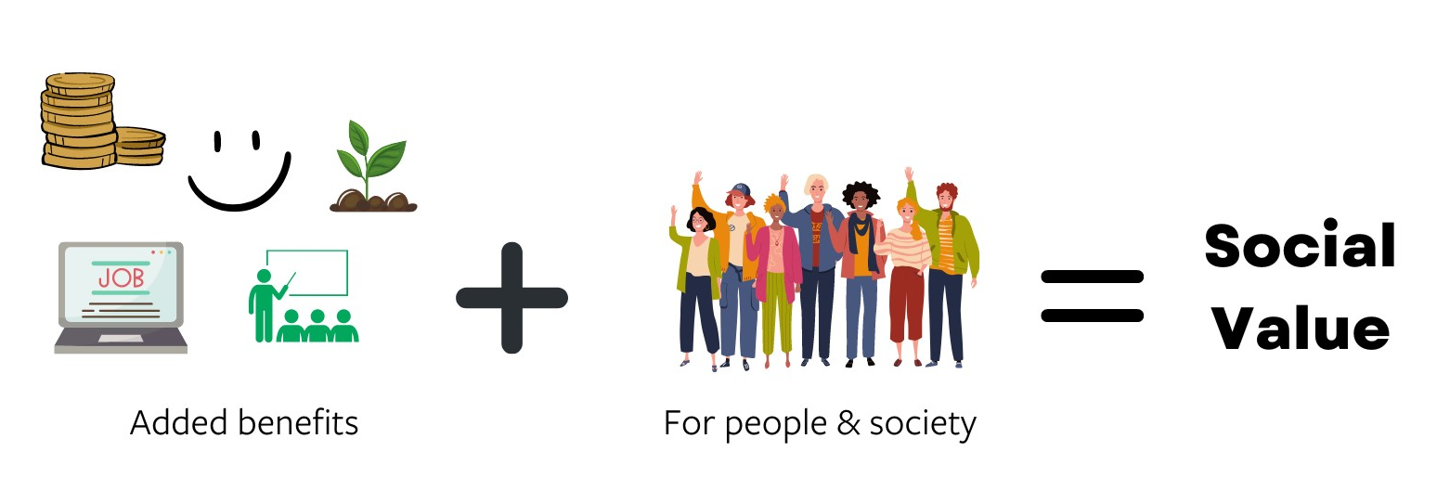
What is social value?
Social value is about…
creating value for society; and
the added economic, social or environmental benefits that an organisation can bring to an area and its people through its activities.
Anything your company does to go over and above legal and contractual requirements to improve outcomes or create additional value for people

Slide 47
Why is social value important to London’s public sector buyers?
Public Services (Social Value) Act 2012
Requires ALL public sector organisations and their suppliers to look beyond the financial cost of a contract to consider how the services they commission and procure can improve the economic, social and environmental wellbeing of an area.
Legislation
Community Wealth Building:
Maximising benefits for Londoners
Worth minimum
10% of overall score

Slide 48
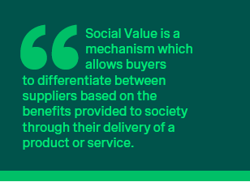
The public sector wants to buy
from suppliers who…
Look after their staff
Behave responsibly and fairly towards their suppliers
Protect the environment
Take action to tackle inequality
Offer maximum value for society
Deliver their products and services in a way which is aligned with the public sector’s values

Slide 49
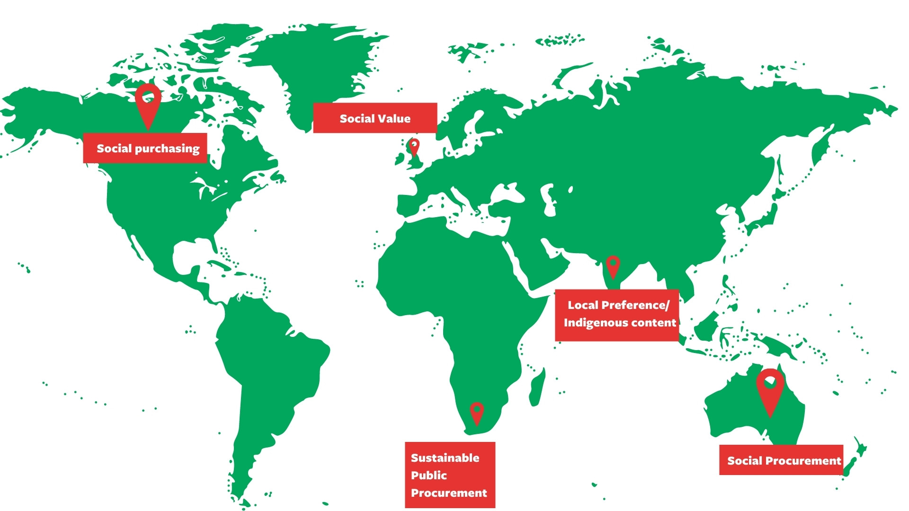
It’s not just the UK public sector…
PURPOSE-LED,
SOCIAL VALUE, RESPONSIBLE BUSINESS,
ESG, SUSTAINABILITY
CSR, COMMUNITY BENEFITS

Slide 50
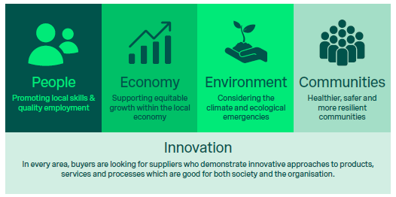
What does social value look like in practice?
Area of impact
Activity conducted
Outcomes

Slide 51
People
Economy
Pay the London Living Wage
Adopt the Mayor’s Good Work Standard and showing how you are delivering on the commitments
Take on Apprentices & offer your workers training opportunities
Target your recruitment activity at people facing disadvantage
Demonstrate your support to help disabled people, ethnic minorities and underrepresented groups
Provide careers talks and mentoring to young people in local schools
Buy from other SMEs and London firms and track your spend with them
Buy from voluntary, charity and social enterprises
Activities which support the physical, mental and financial wellbeing of your workers
Provide equality, diversity & inclusion training for all staff
Follow guidance to reduce the risk of modern slavery and unethical work practices in your business and supply chain

Slide 52
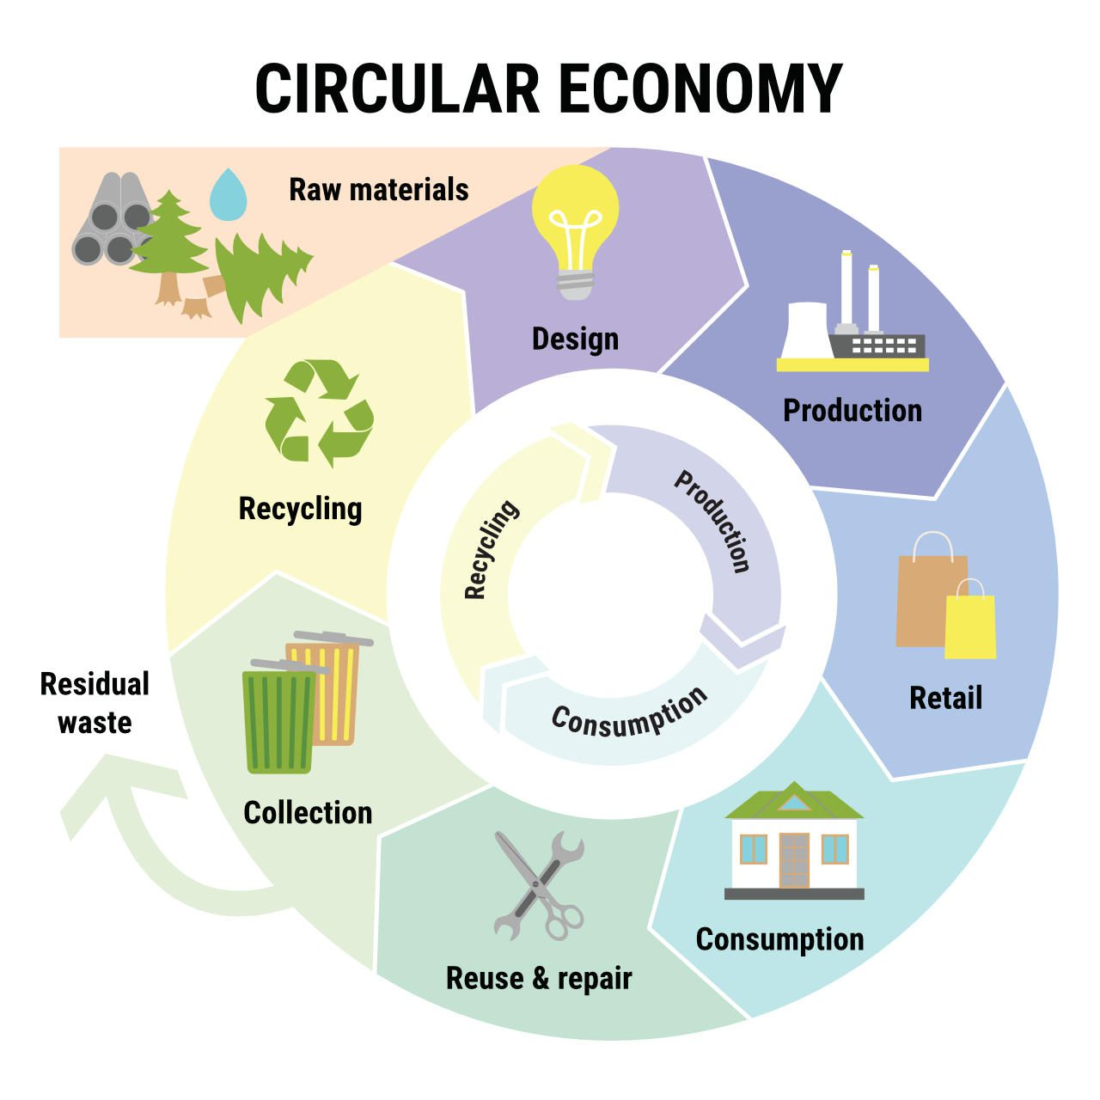
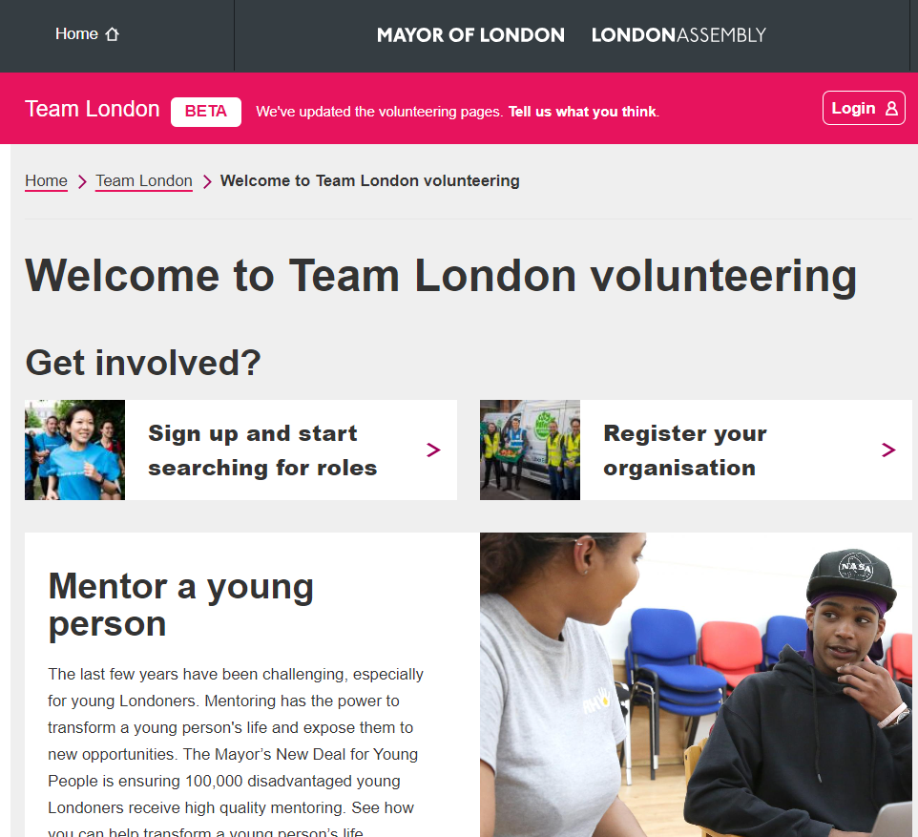
Environment
Community
Reducing waste, energy and water usage
Committing to achieving Net Zero.
Monitoring and tracking carbon emissions and reporting annually on progress
Using Low and Zero Emissions Vehicles
Eliminating plastics
Adopting circular economy principles across your business
Initiatives which help improve biodiversity & enhance London’s green spaces
Support for community initiatives including charities and third sector organisations
Volunteering
Fundraising and donations
Pro bono professional support

Slide 53
Ideas sharing
Introduce yourself
Say hello
Talk about your business and ask
about theirs
Ask your neighbours
What social value are you doing?
Who does it help?
How do you quantify and record it?
Think about
What does your business do that creates social, economic and environmental benefits for people?
What else could you do?

Slide 54
Strengthening your response

Slide 55
How do buyers request & evaluate social value?
The way buyers request and evaluate social value can vary significantly across buying organisations but there are some common elements which every social value response will likely ask you to provide:
Specific Commitments – What you are promising to do
Context – Why what you are proposing is of value (& how it relates to the contract)
Method Statement/Delivery Plan - How you will do it
Proposed KPIs - Methods for monitoring and reporting

Slide 56
How is social value measured?
Units of measure
Impact
Activity
Be specific about the activity you will conduct and make clear commitments
Align the delivery plan to the contract
Think about the units you can use to measure the activity
Demonstrate how you will evidence and record your activity
What changes as a result of your actions?
How can your impact on the outcome be demonstrated and evidenced? (Can be both quantitative & qualitative)
Value the impact (proxy £)

Slide 57
Buyers want to see
Specific Commitments
Clear method statement and delivery plan.
Outline what you will do, how you will do it and when you will do it by.
Which relate to the contract
Make commitments which are relevant and proportionate
Do your homework – make your commitments relevant to the area where the contract is being delivered.
Confidence that you will deliver
Provide realistic KPIs
Detail how you will monitor and track activity internally
Name the person who will be responsible for delivery and reporting of social value commitments

Slide 58
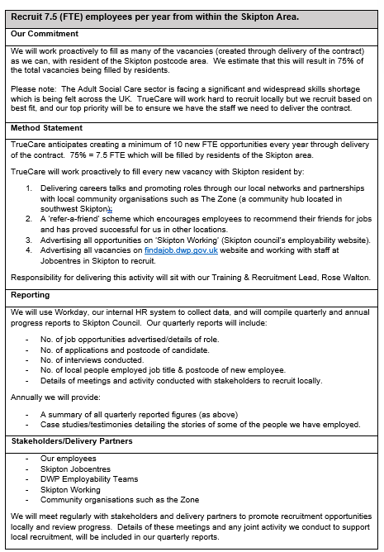
What does that look like?
Disclaimer: For illustrative purposes only. All places and companies/ organisations named are imagined.

Slide 59
Finally….
Go for quality over quantity
Don’t be tempted to offer everything – doing a few things well is better than
lots of things badly (or not at all).
Read the tender document.
Make sure you understood how the buyer is scoring social value and that
you have thoroughly read all documents associated with the bid.
Don’t be afraid to ask a clarifying question.
Ask for clarification if there’s something you’re unsure of.
Get someone else to check your answer before you submit it.
Having someone else read your answer and make sure it’s been checked
by the people who will be expected to deliver the commitments you’re making.

Slide 61
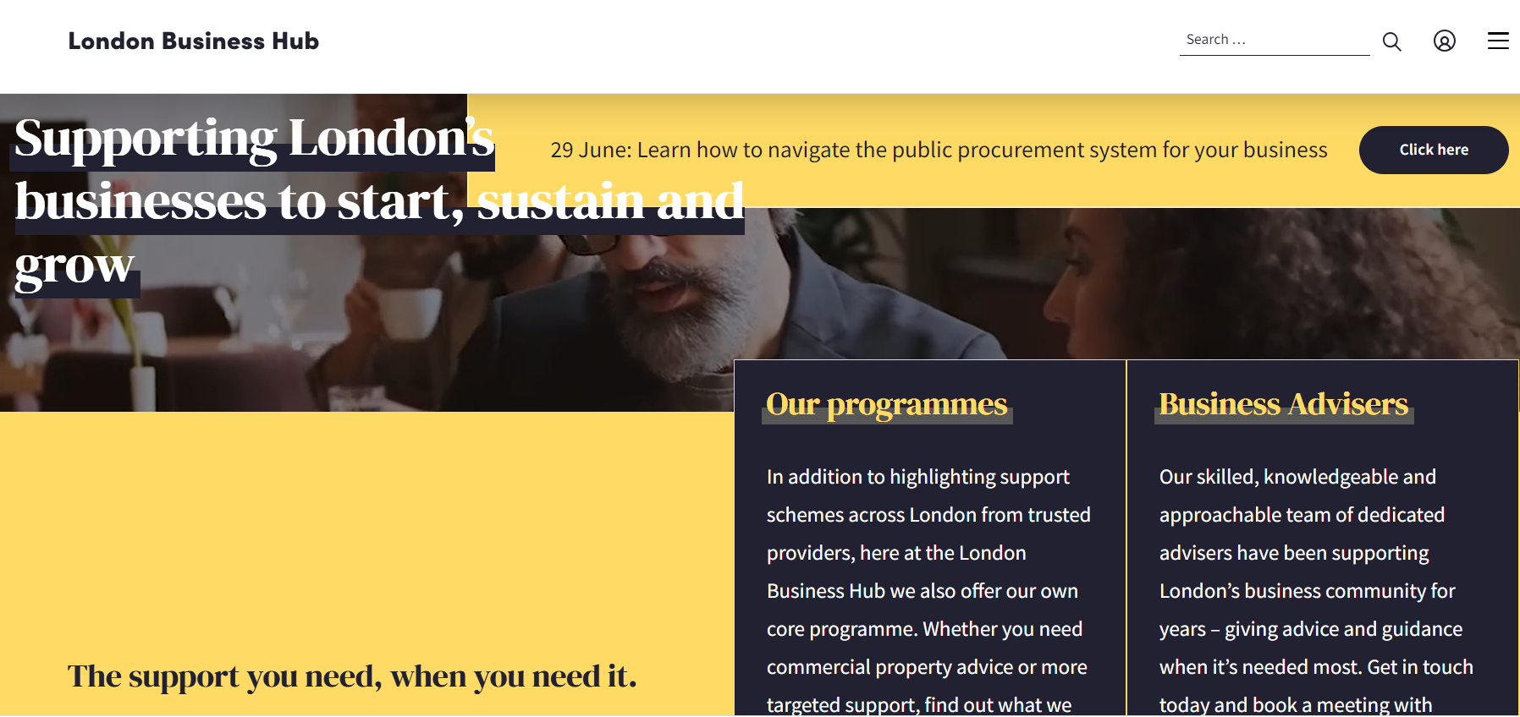
Further resources

Slide 62
sarah@samtaler.co.uk www.samtaler.co.uk

Slide 63
Next steps 1. Share your thoughts with us on today 2. Sign up to the London Business Hub’s portal and newsletter here: 3. Check out useful resources on our dedicated webpage:
https://www.businesshub.london/register/
https://www.businesshub.london/resource/sme-procurement-hub/
www.anchors.london
#LondonAnchors
Notes:
OPTION COVER 1

Slide 64
Thank you for joining us today marketing@businesshub.london
www.anchors.london
#LondonAnchors
Notes:
OPTION COVER 1

