Slide 1
MENTORING FOR NEETs: A Review of What Works & Promising London Models
June 2021

Slide 2
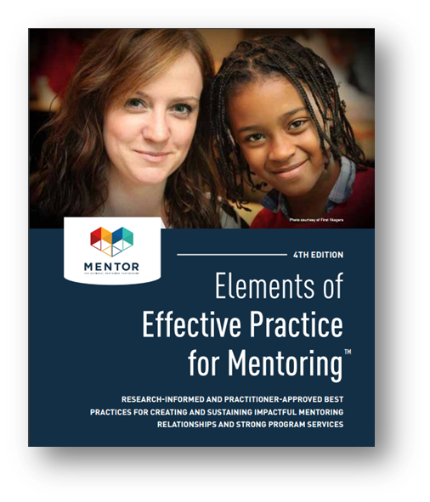
What Makes a Good Mentoring Program
Starts w/ a Theory of Change
Recruits Skilled, Credible Messengers
Utilizes a Developmental Framework for Relationship Building
Strengths-Based Approach
Consistent Monitoring & Support

Slide 3
Starts With a Theory of Change
Every mentoring program must have a theory of change that explains how the mentoring services, and corresponding activities, will result in the desired outcomes at the participant and community/institution level.
A good theory of change should:
Illustrate how the program design and other external factors bring about change, and influence effectiveness.
Explicitly show how a program, through the work of a mentor, achieves meaningful and measurable results.
Draw on relevant research to support program design and show alignment with local needs and contexts.

Slide 4
EXAMPLE MODEL: THEORY OF CHANGE XLP
Matches an at-risk young person with a trained mentor who encourages them to make positive choices. Matches commit to meeting up for two hours each week for a minimum of 12 months.
Theory of Change Features
Clear Aim - Ensure young people stay in education, aren’t involved in gang culture or anti-social behavior, and achieve their goals
Inputs reflect internal assets of the program such as org culture and practice
Activities clearly aligned to Outputs & Outcomes

Slide 5
Recruit Skilled, Credible Messengers
Recruit mentors whose skills, motivations, and backgrounds best match the goals and structure of the program. Think more holistically about the characteristics that would make someone a good fit to work with NEETs by taking a deeper look at the individual needs of young people.
Mentor Characteristics to consider in recruitment:
Availability & Proximity
Culturally competent
and humble
Social justice mindset
Experience giving effective feedback in a relevant teaching or advocacy role
Expresses care for youth and the community
Notes:
Make sure that your recruitment messages are clear about what the mentoring you provide these youth looks like.
Take a deeper look at the needs of the youth who come into your program and think about them as individuals and not a homogenous group.
Culturally competent -

Slide 6
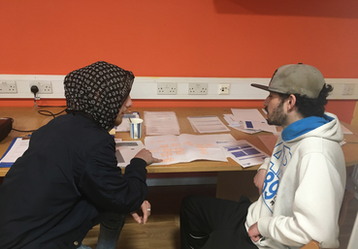
EXAMPLE MODEL: CREDIBLE MESSENGERS The Mentoring Lab
Young mentees are guided by peer mentors who go through the Lab’s Mentoring Tool Kit, packed with reflective activities that aim to support young people's progressing at school and personal life.
Key Features
Tool Kit focuses on developing qualities, confidence, focus and natural talents of mentees
Peer Mentor training demonstrates how to develop sound peer mentoring relationships that safeguards both the peer mentor and mentee
Topics include peer mentor identity, trauma-informed practices, and maintaining professional boundaries

Slide 7
BUSINESS EXAMPLE: CREDIBLE MESSENGERS SVC2UK 2015 CEO Summit
Silicon Valley Comes to the UK (SVC2UK) programme was an invitation-only series of events which matched successful entrepreneurs as mentors for founders of young startups.
Key Mentoring Highlights
Mentors came from partners of SVC2UK, SVC2UK alumni, and those with expertise of scaling up businesses.
Ratio of mentors to CEOs was 4:6
Mentors actively ask questions, challenge our CEO and founders' thinking, and provide detailed feedback and advice.

Slide 8
Utilizes a Developmental Framework for Relationship Building
Search Institute identifies developmental adult-youth relationships as those that help young people
Discover who they are
Develop abilities to shape their own lives
Learn how to engage with and contribute to the world around them
1
2
3
4
5
Express care
by making young people feel known and valued
Challenge growth
by pushing young people to go further and learn from mistakes/ setbacks
Provide support
by helping navigate difficult situations and building confidence
Share power
by involving young people in the decisions that affect them
Expand possibilities
through exposure to new ideas, experiences and opportunities
The Framework is a mix 5 elements expressed through 20 actions
Notes:
Express care through listening, encouragement, and making young people feel known and valued.
Challenge growth by pushing young people to go further and help them take responsibility for actions and learn from mistakes and setbacks.
Provide support by helping navigate difficult situations and building confidence.
Share power by involving young people in the decisions that affect them and encouraging opportunities for advocacy and leadership
Expand possibilities through exposure to new ideas and experiences and connecting young people with opportunities

Slide 9
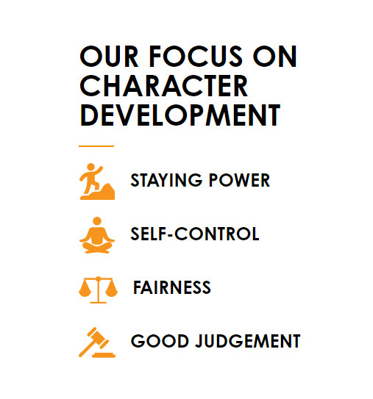
EXAMPLE MODEL: DEVELOPMENTAL FRAMEWORK Reach Out UK
Mentoring sessions, team activities and workplace learning, provide young people with the skills needed to achieve better grades and successfully find employment, education or training.
Key Features
Mentors express care by encouraging mentees to express their ideas and thoughts through academic work
Mentees are challenged to increase class and non-academic participation and form friendships leading to improved social skills
Mentees share power with mentors through collaborative goal setting and weekly reflections
Notes:
Reach Out focuses on Character Development in order to create strong relationships and youth outcomes

Slide 10
Strengths-Based Approach To Mentoring
The strengths of NEETs and the strengths of their communities, families, and cultures can be drawn on to bolster their potential for success.
Like schools and other youth-serving institutions, mentoring programs find success through:
Consider the use of activities that allow mentors and mentees to explore culture, heritage, history, and the background of their communities.
delivering culturally relevant services
developing the strengths of those they serve
building on the assets of the local community
Notes:
It is important that mentoring for NEETs is approached from a strengths-based perspective. Challenges NEETs face can be mitigated through mentoring relationships…
Identifying, respecting, and building upon the strengths of mentees, as well as their communities and social networks, can go a long way toward supporting mentoring relationships.
In addition to helping mentees explore their social capital, social-network mapping can be helpful to explore community and family human resources in support of the mentoring relationship, and to better understand the mentee’s environment.

Slide 11
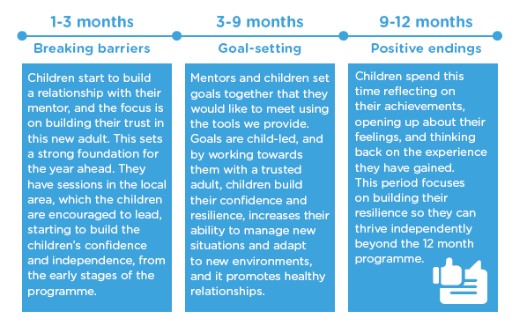
EXAMPLE MODEL: STRENGTHS BASED APPROACH The Kids Network
The Kids Network is a community of children and volunteer mentors connecting through fun, friendship and hardship for positive social change.
Key Features
Volunteer mentors come from the same local London community as their mentees.
Mentors provide a sense of stability for mentees to explore their identity and express themselves in a safe environment.
Mentee-led sessions are held in the local area, and goal setting is driven entirely by the youth.

Slide 12
Consistent Monitoring & Support
Monitor relationship milestones and child safety. Support matches by providing
ongoing advice, problem-solving, training, and access to
resources
Monitoring should be consistent and frequent. Programs should contact mentors and
mentees at a minimum frequency of twice per month for the first
month and once a month thereafter
Parent support and involvement in the mentoring relationship impacts the effectiveness
of mentoring on youth outcomes and the strength of mentoring relationships.
Notes:
Regular contact between mentors and mentees with program staff has been associated with longer-lasting mentoring relationships, as well as more frequent meetings between mentors and mentees and stronger mentoring relationships.
Hosting group activities for mentors, mentees, and mentees’ families provides an opportunity for parents or guardians to be involved and express their support for the mentoring relationship

Slide 13
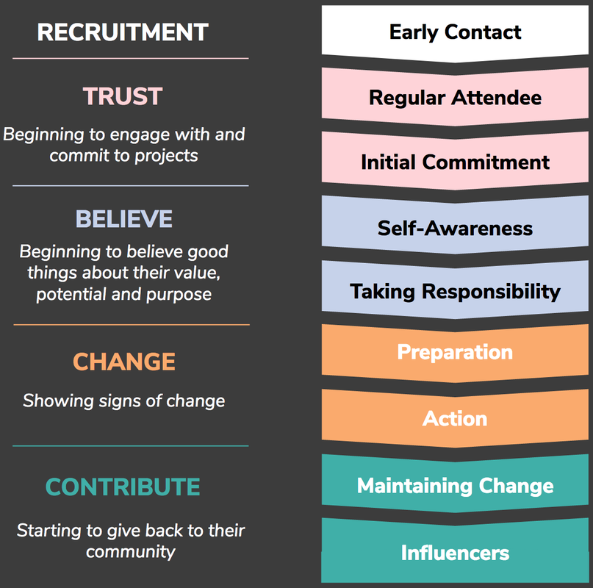
EXAMPLE MODEL: PROGRESS MONITORING & SUPPORT XLP
Young people are referred to the project by schools, pupil referral units, youth services or the police. XLP recruits and trains mentors from the young person’s local community. Mentors are then matched by XLP with a suitable referred young person.
Key Features
For each borough, a full-time experienced youth worker is assigned to monitor and supervise mentoring relationships.
The youth worker manages up to 25 active mentoring relationships and supports the mentors, mentees, and the mentees’ families throughout the process.

Slide 14
BUSINESS EXAMPLE: PROGRESS MONITORING Mayor’s International Business Programme
The Mayor’s International Business Programme (MIBP) helps ambitious high-growth companies from London’s technology, life sciences and urban sectors to expand their businesses internationally.
Key Mentoring Highlights
One-to-one and one-to-many mentoring and ongoing guidance from entrepreneurs and business leaders (“meet the mentor” roundtables)
A dedicated program team supports managing expectations and the relationship’s development between matches
The opportunity to join high-profile targeted trade missions led by the city’s team of international business experts
Notes:
Focused workshops and events that provide the opportunity to learn from expert advisers
The Mayor’s International Business Programme is supported by five lead partners: KPMG, BDO, Benoy, PA Consulting and the London Chamber of Commerce and is partly funded by the European Regional Development Fund. It aims to support 800 businesses assisted and outcomes will be £50m sales generated and 500 jobs created within the lifetime of the programme
The program team allocated mentors to mentees, carefully curated the relationships, and did regular follow ups to make sure expectations were being managed and mentors were not being overwhelmed. We also arranged one-to-few “meet the mentor” round tables. E.g. 6-10 retail-tech founders had a 90 min round table with the CEO and founder of ASOS to share their challenges and learn from his experience/ mistakes.
Where we were supporting startups to expand into an international market, we also arranged meet-the-mentor round tables with mentors who were operating in the market. We partnered with KPMG, and others to source the mentors.

Slide 15
Measuring Key Metrics: Implementation
Program Implementation
Identify indicators and benchmarks that can be tracked to determine if the program is being implemented as intended and aligned to the theory of change.
Common Indicators:
Number of mentors recruited and available for matching
Frequency and duration of match meetings
Participation in training opportunities
Overall match length
Time spent waiting to be matched
Adherence to match monitoring and support procedures

Slide 16
Measuring Key Metrics: Outcomes
Participant Outcomes
Developing a strong theory of change will identify several measurable indicators of positive outcomes for program participants. Programs are also encouraged to think about outcomes for mentors and the community as a whole.
Common Outcomes to consider for NEETs:
Improvement in social-emotional development
(e.g., self-esteem, connection to prosocial peers)
Improve youth positive adaptation and functioning
(e.g., positive mental and physical health, prosocial behaviors)
Reduce internal and external risk factors
(e.g., attitudes predisposing to criminal activities, financial stress)
Work placement & employment leading to long-term financial independence

Slide 17
ANCHOR INSTITUTION SPOTLIGHT: YOUTH SUPPORT & MENTORING Transport for London (TfL)
TfL engages in a multitude of youth outreach and mentoring programs in partnership with the university system. Their commitment to young Londoners can serve as an exemplary model to its fellow Anchors across the city.
Key Highlights
The Employability and Young People Outreach Programme aims to diversify staff and improve quality of life in London by focusing on skills training for younger people and people with barriers to work.
Volunteer Mentoring Programmes include STEM Ambassadors where employees aim to encourage students in school to pursue a STEM Career
The Innovate Schools Challenge is a team competition and school project for 16-19 year-olds linked to work experience opportunities.

Slide 18
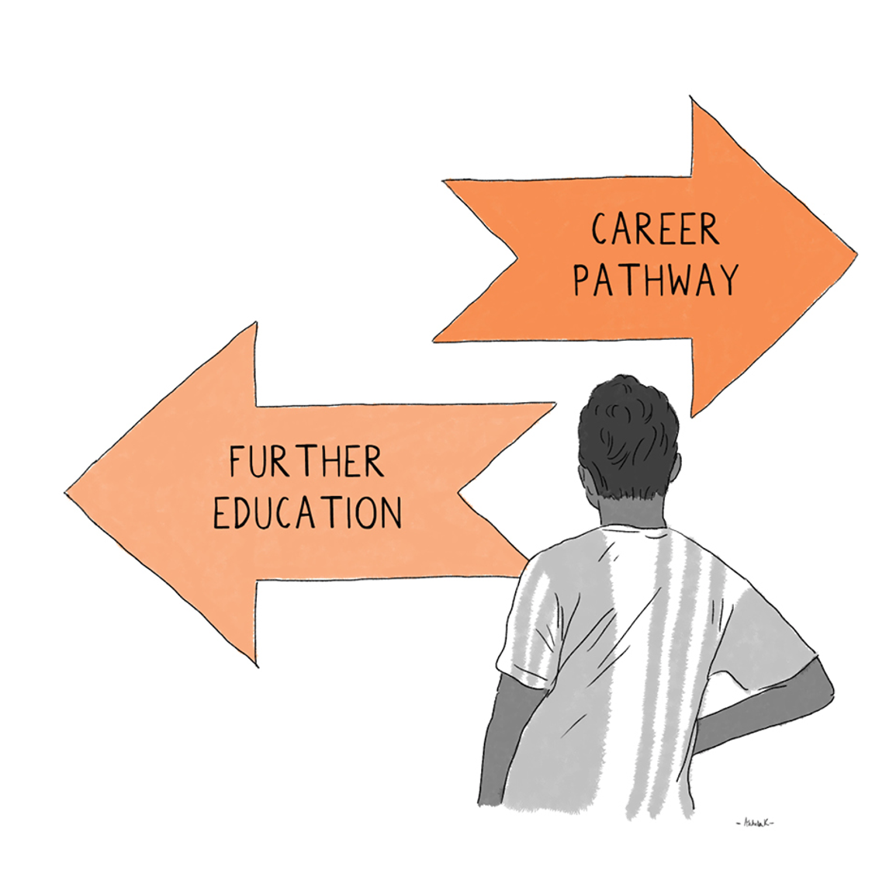
New Deal for Young People – Draft Mentoring Quality Statement
Setting expectations and evidencing impact – Mentors should jointly set expectations with the young person and organisations should be able to systematically demonstrate the impact of their mentoring.
Type of activities - Youth mentoring programmes are particularly effective when mentors employ targeted approaches matched to the needs of their mentees rather than a one-size-fits all approach. It is important that the mentor listens and responds to the needs of the mentee.
Duration and frequency - Studies show that longer relationships between mentees and mentors are associated with better outcomes. High levels of commitment and communication from mentors is important when building the relationship, and regular contact has been shown to be key to the success of mentoring relationships.
Youth voice - Young people should be given opportunity to shape and direct the mentoring. This could include the design and evaluation of the programme as well as directly being able to communicate what support they need.

Slide 19
New Deal for Young People – Draft Mentoring Quality Statement
Characteristics of a mentor - Positive outcomes ultimately rely on the formation of a positive connection between mentor and mentee. Factors such as trust, empathy, authenticity, and mutual respect are considered critical to a quality mentor relationship.
Creating Matches - Matching mentees and mentors with shared backgrounds and matching in a culturally sensitive way are important for effective mentoring programmes. Shared backgrounds include values, beliefs and interests. Matching processes that give choice and agency to mentees are seen to be effective.
Training of Mentors - Mentors need to be equipped with the skills to support young people. Upfront as well as ongoing support, training and supervision for mentors is key.

Slide 20
THE END

