Slide 1
Leadership for change Pledging to support the Anchor Institutions’ Mentoring for Young People Goals

Slide 2
Programme context
In March 2021, 14 founding organisations signed London’s first ever city-wide Anchor Institutions’ Charter, pledging to work collaboratively to support the city’s recovery from the pandemic.
Collectively, these organisations, including [your institution], spend over £73 billion a year on goods, works and services.
There are now 16 member institutions, and we continue to welcome new members.
Founding signatories to the Charter:
Association of Colleges
Film London
Greater London Authority
London Chamber of Commerce & Industry
London Councils
London Fire Brigade
London First
London Jewish Forum
Metropolitan Police
Muslim Council of Britain
NHS London
Thames Water
Church of England
Trades Union Congress (London and East and South East)
TfL
University of London

Slide 3
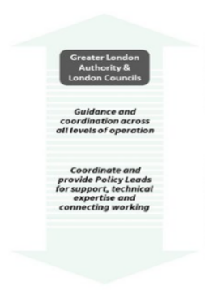
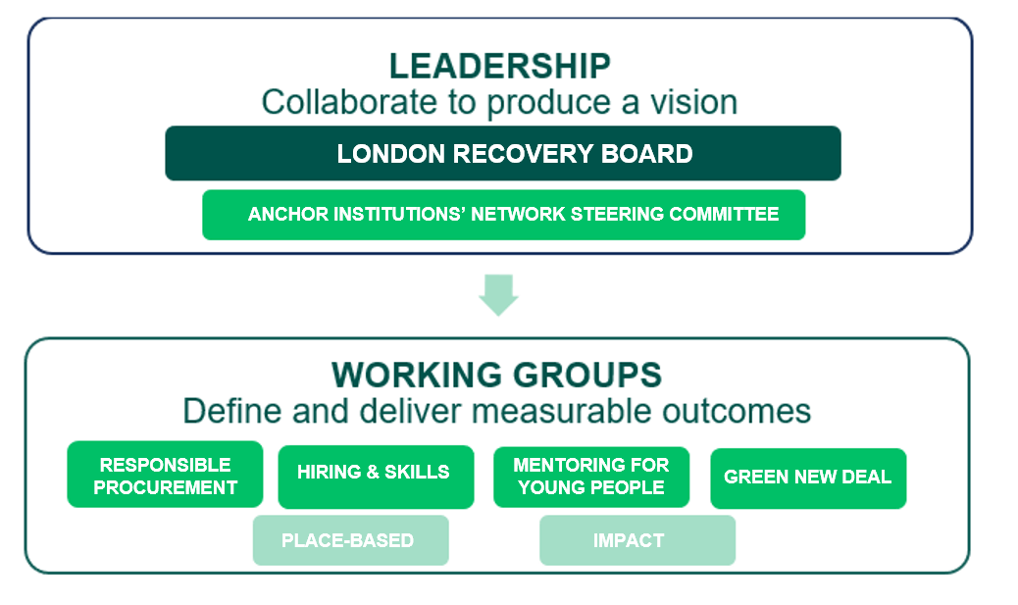
Governance
The network is led by a Steering Committee, bringing together senior representatives from member organisations, who meet twice a year to drive the programme forward and support collaboration.
4 workstreams are focused on Procurement, Mentoring for Young People, Hiring and Skills, and Green New Deal, whilst 2 additional groups are developing a framework for measuring social impact and building local relationships.

Slide 4
Our potential for impact
We’ve listened to young people about the ways that the pandemic has affected their life chances, and we’ve heard about the transformational impact that mentors and role models have on a young person’s life.
A positive, caring relationship with a trusted adult can promote personal development and wellbeing, and enable a young people to access additional opportunities and support provided by a range of agencies.
By deepening your engagement with young people through high quality mentoring programmes and services, you can play a major role in building a skilled and diverse talent pipeline for the future of work; addressing social-economic inequality; and boosting local economies. Together we can fuel our city’s recovery from the pandemic and help young people in the greatest need.

Slide 5
A values-driven business model that prioritises social responsibility
Today, your customers, employees, and stakeholders are evaluating how your activity is impacting the community, our economy, our environment, and wider society. They are interested in whether or not you care about social responsibility, over and above profit.
To be authentic, your socially responsible practices need to be integrated into your culture and business operations. Corporate social responsibility is a business practice that prioritises social accountability and having a positive impact on society, including through voluntary work and young mentoring.
Studies have found that CSR:
Improves brand perception amongst consumers (The Kantar Purpose 2020 study)
Attracts and retains employees (The Deloitte 2022 Global Millennial and Gen Z Survey; The 2020 Porter Novelli Purpose Tracker)
Increases your appeal to investors and potential partners (The Deloitte 2022 Global Marketing Trends report; CECP 2021 Giving in Numbers™ report)

Slide 6
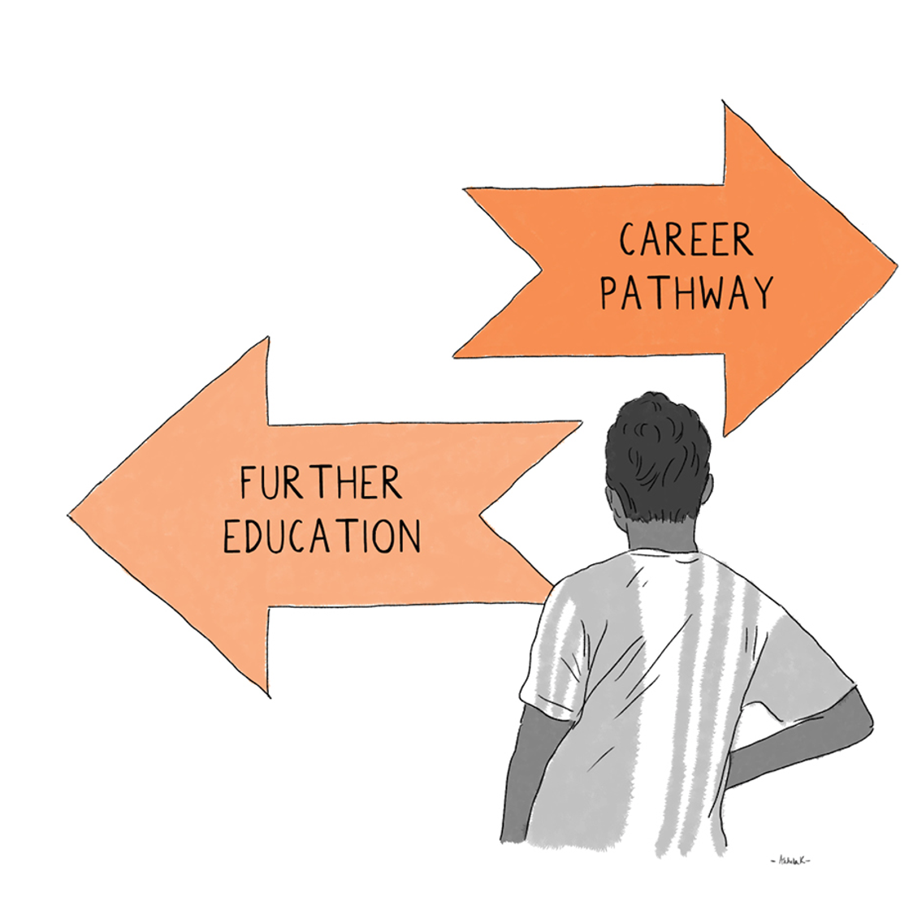
I’m in. What’s next?
1. Make a public pledge – establish a baseline, set your target, and make a public commitment to meeting this target. By making your goal public, you’re more likely to achieve it.
“We’re working towards recruiting # employee volunteers each year by 2024”
“We’re committed to funding support for this service at a cost of £650 per session annually”
“We’re working towards referring # local young people to quality mentoring programme in areas where we conduct business each year”
“We’re working towards recruiting # mentors and/or young people through promotions and other communications across our industries/communities in which we work”
“We’re providing # hours of technical assistance to mentoring programmes and other local charities located in areas in which we operate”

Slide 7
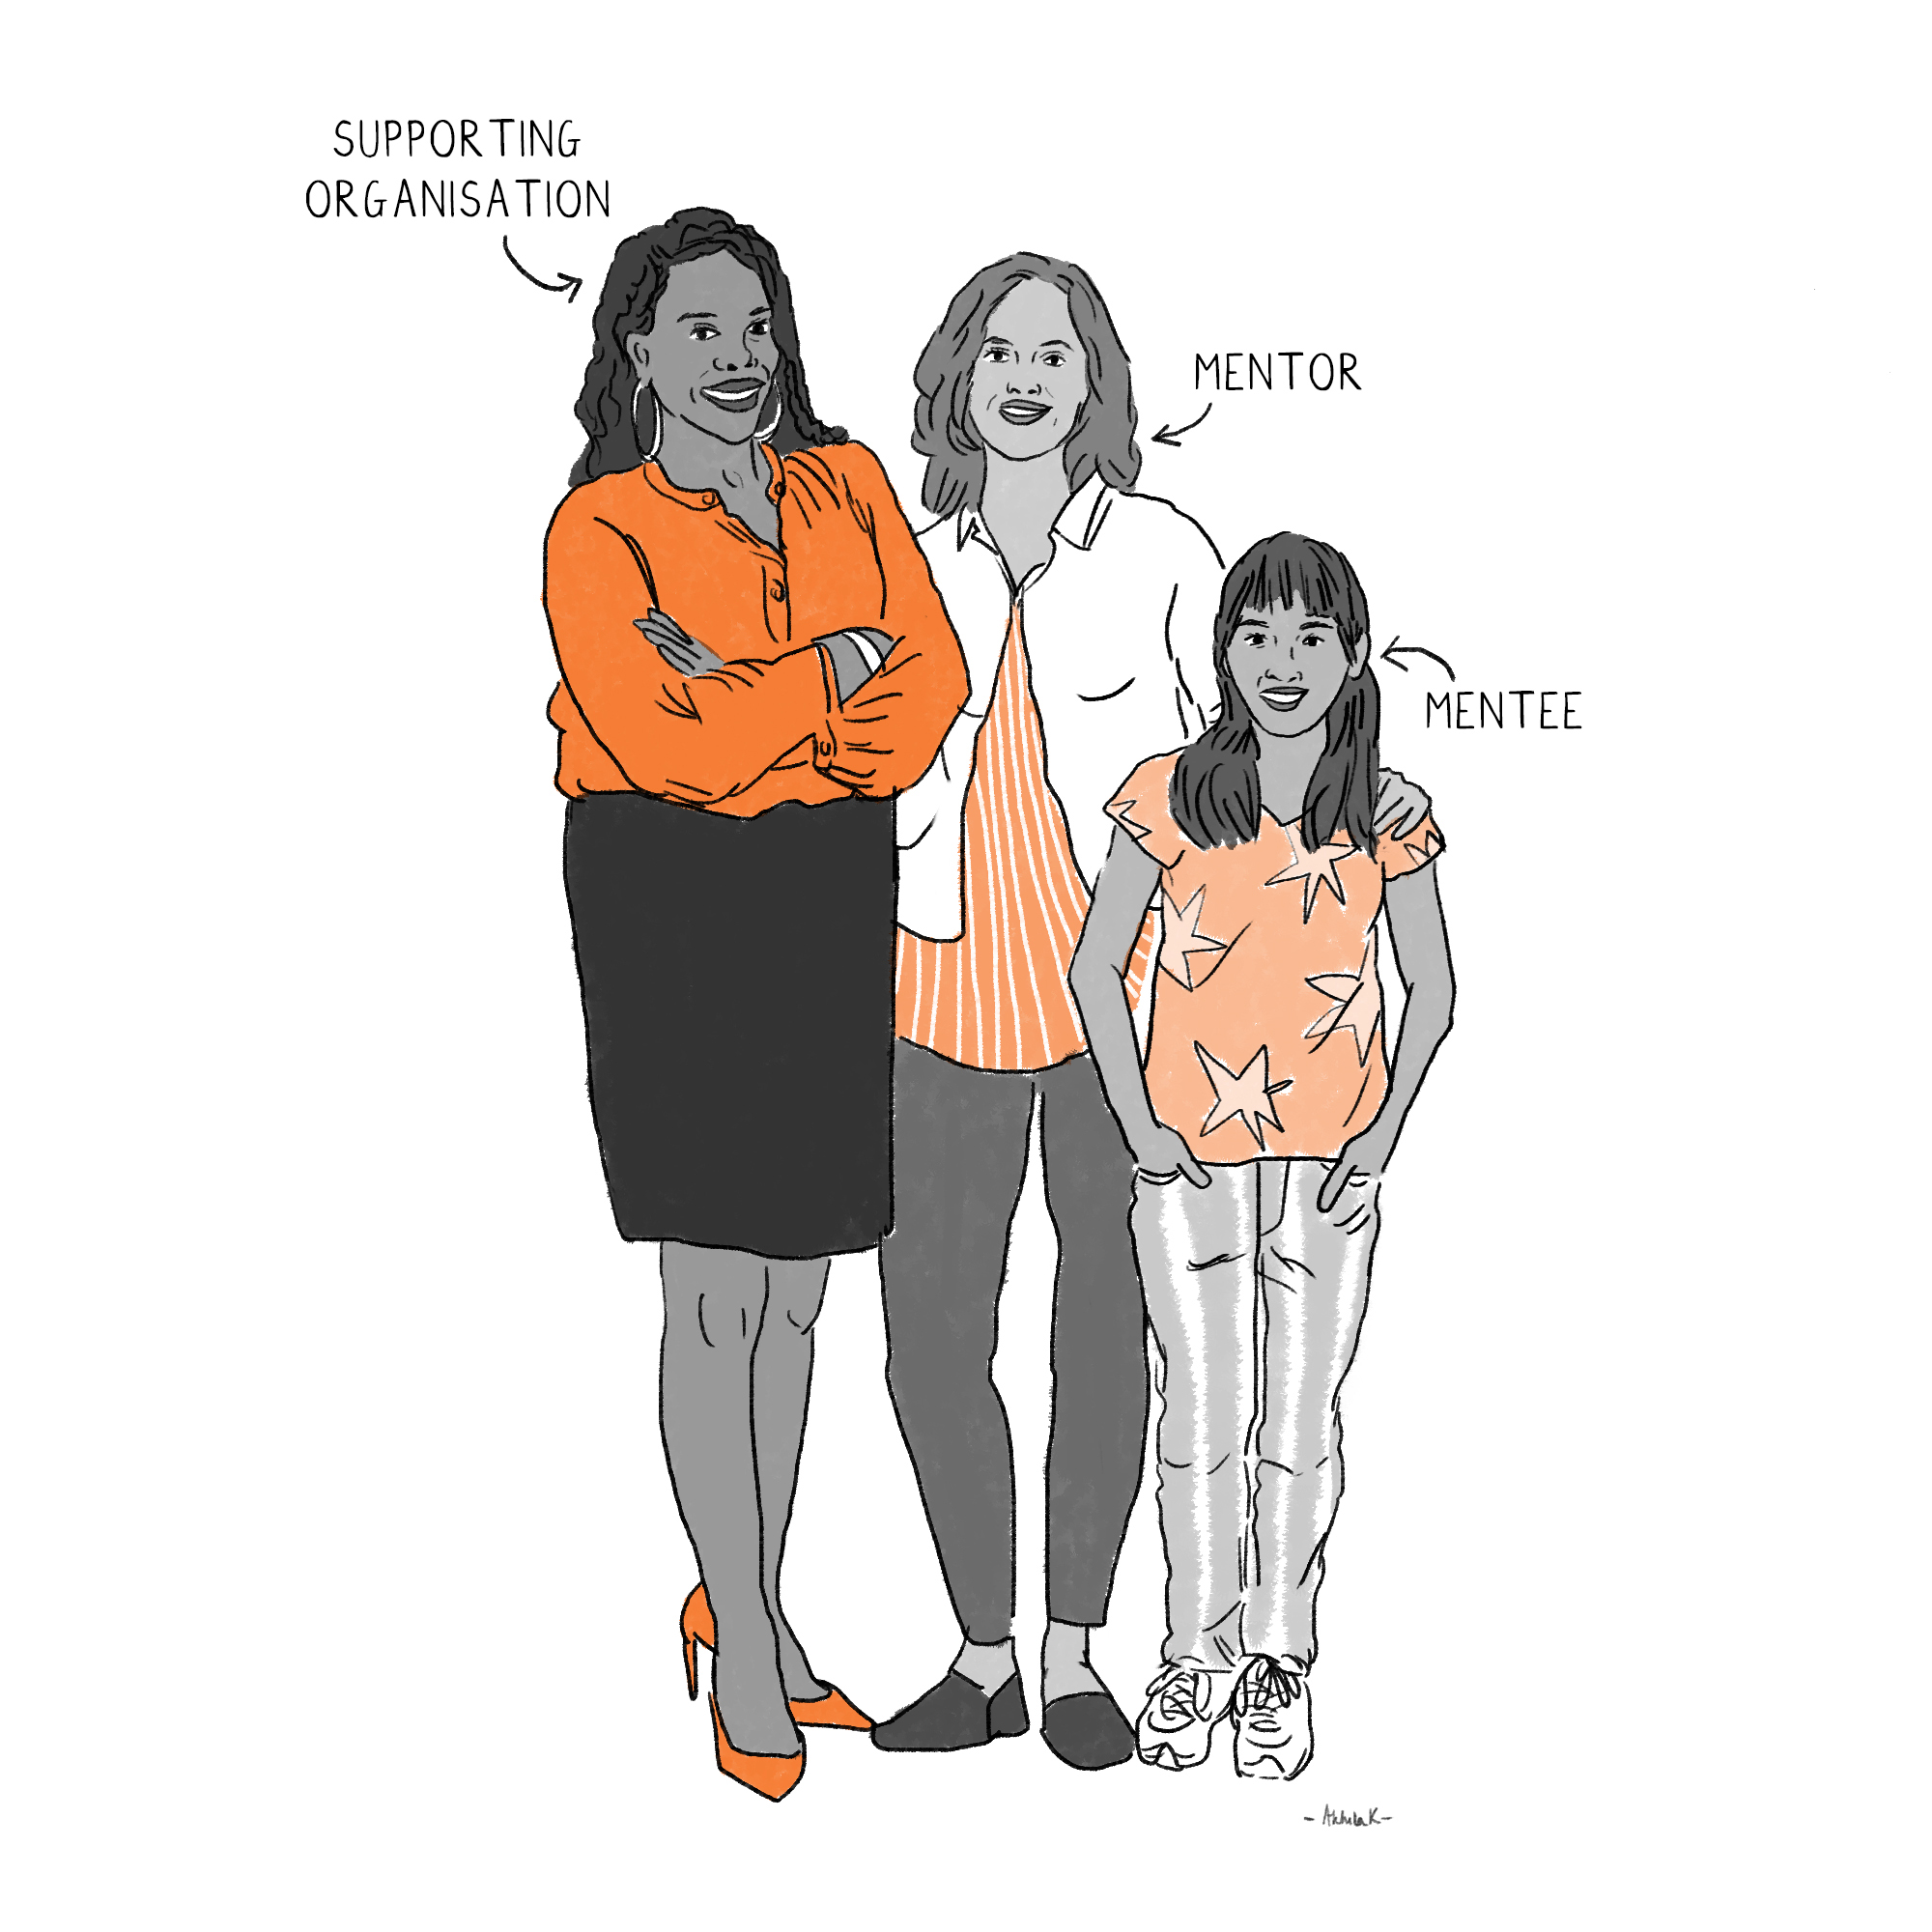
I’m in. What’s next?
2. Plan how to get there with the support of the network – determine which service delivery model your organisation is best suited to contribute to and identify a New Deal for Young People grant recipient that serves young people in the boroughs in which you conduct business, who you can partner with to begin contributing towards your pledge.
How do we identify a New Deal for Young People grant recipient or a local charity that mentors young people in the communities in which we conduct business?
Bloomberg Associates is able to support institutions to develop implementation plans and support partnership development for New Deal for Young People grantees. Contact Linda Gibbs: lgibbs@bloomberg.org and Garrett Richardson: grichardson@bloomberg.org

Slide 8
3. Join the network – one immediate, tangible contribution you can make to this work is to sign the Charter and share your interests in response to the requests from the below New Deal for Young People grant recipients:
One Million Mentors (STEAM Mentoring)
Sister System (Leaders)
Resources for Autism (Leaders)
Connection Crew (STEAM Mentoring)
SYNC (Young Hammersmith and Fulham Foundation Consortium) (Leaders)

Slide 9
Pan-London Quality Mentoring Delivery Model
VCS managed
Primary delivery model
Recruitment, screening, matching, and supervision
Private/public sector partnered
Reflect the same quality of service as VCS managed process
VCS Matched: match private/public sector mentor recruits to the VCS managed process
Private/public sector managed
Reflect the same quality of service as VCS managed process
Company owns all service delivery responsibilities
Adopts and promotes mentoring framework
Private Sector Partnership: VCS offers guidance while company manages service delivery in-house
Encouraged to adopt and promote Framework; serves target youth populations where appropriate

Slide 10
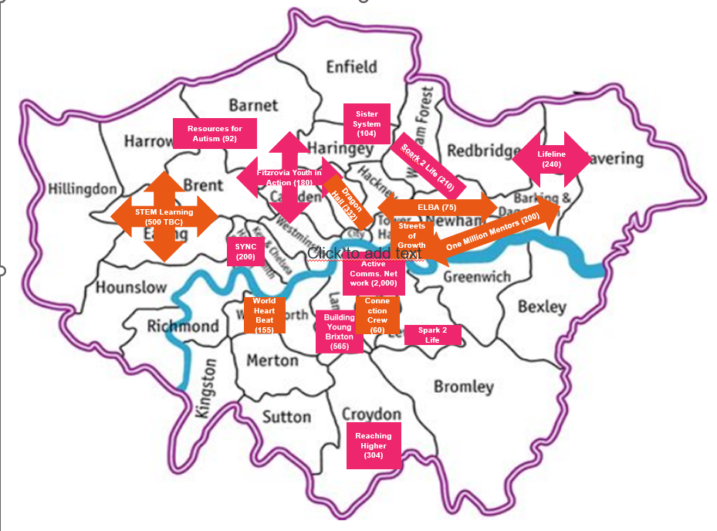
Delivery locations
Successful Organisations
Leaders
STEAM
Headstart Action
London Youth
Family Action

Slide 11
Why join the network?
The key to success for all of us is buy-in from leaders of London’s major institutions.
Our goals are bold and ambitious. However, young people are facing unprecedented challenges that demand solutions championed by leadership. Anchor institutions will need to dedicate their management and employee’s time and resources to leading volunteer efforts. And they will need the support and encouragement of leadership.
Anchors’ leaders will need to communicate what they value and incentivise social responsibility and progress towards shared goals.
Our ask:
1. Will you make it a priority of your organisation to support local charities delivering mentoring services?
2. Will you make a public pledge, communicate to local stakeholders, champion it at board level and review progress at senior management meetings?
3. Will you support staff to follow through? e.g. Supporting volunteer hours during the working day and embedding volunteering into performance management

Slide 12
Contact us: Recovery@london.gov.uk

